Slide 1
Time-to Degree: Bachelor’s Degree Completion for Latine First-Year & Transfer Students
Robert Kunicki
Urban Education Ph.D. Program
The Graduate Center, CUNY
Dissertation Committee
Professor Juan Battle (Chair), The Graduate Center, CUNY
Professor Anthony Picciano, Hunter College & The Graduate Center, CUNY
Professor Limarys Caraballo, Teachers College, Columbia University & The Graduate Center, CUNY

Slide 2

Research Questions
What is the relative impact of college completion programs, academic momentum, and key demographic variables on the length of time it takes Latine students to earn a bachelor's degree?
How do these domains impact time-to-degree for transfer Latine students and first-year Latine students respectively?

Slide 3


Statement of the Problem
Equity gaps in Latine educational attainment (Carnevale & Fasules, 2017, Schak et al., 2019)
Concentration at certificate and associate’s level (Hussar et al., 2020)
Bachelor’s degree outcomes (Horn & Skomsvold, 2011, U.S. Department of Education National Center for Education Statistics, 2017)
Lengthening time-to-degree (Bound et al., 2012, Princiotta et al., 2014, Witteveen & Attewell, 2021, Zarifa et al., 2018)
Influences on time-to-degree
  First Year Students
  Transfer Students

Slide 4
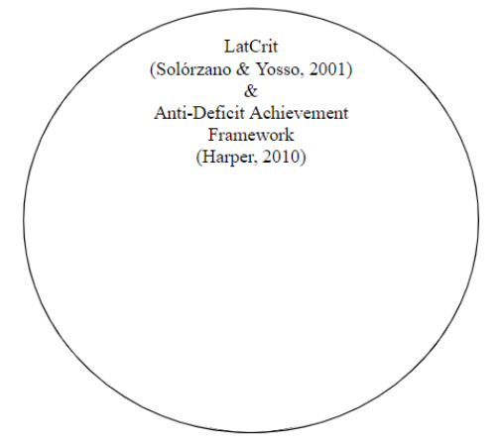

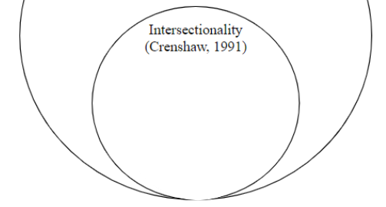
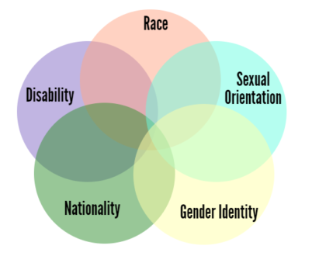
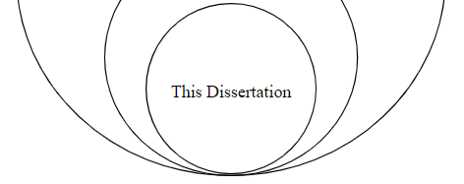
Theoretical Framework

Slide 5
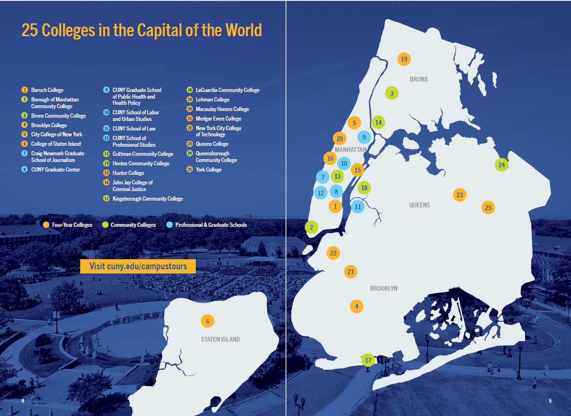
Data
City University of New York Policy Tracking Cohort (PTC)
De-identified student records from Fall 1999 - Fall 2019
Bachelor’s Degree Granting Institutions
  12 Colleges
  43,969 Hispanic Students

Slide 6
Models of Analytical Plan
College Completion Programs
(Holcombe & Kezar, 2020; Scrivener et al., 2015; Todorova, 2019)
(Attewell & Monaghan, 2016; Huntington-Klein & Gill, 2020)
Academic Momentum
Educational Outcome:
Time-to-Degree
Demographics
(Carales, 2020; Núñez, 2014)

Slide 7
Hierarchical Regression Models
Dependent Variable: Time-to-Degree for Latine Students
 | All Students |  |  | Transfer Students |  |  | First-Year Students
Models: | I | II | III | IV | V | VI | VII | VIII | IX
College Completion Programs | ✓ | ✓ | ✓ | ✓ | ✓ | ✓ | ✓ | ✓ | ✓
Academic Momentum |  | ✓ | ✓ |  | ✓ | ✓ |  | ✓ | ✓
Demographics |  |  | ✓ |  |  | ✓ |  |  | ✓

Slide 8
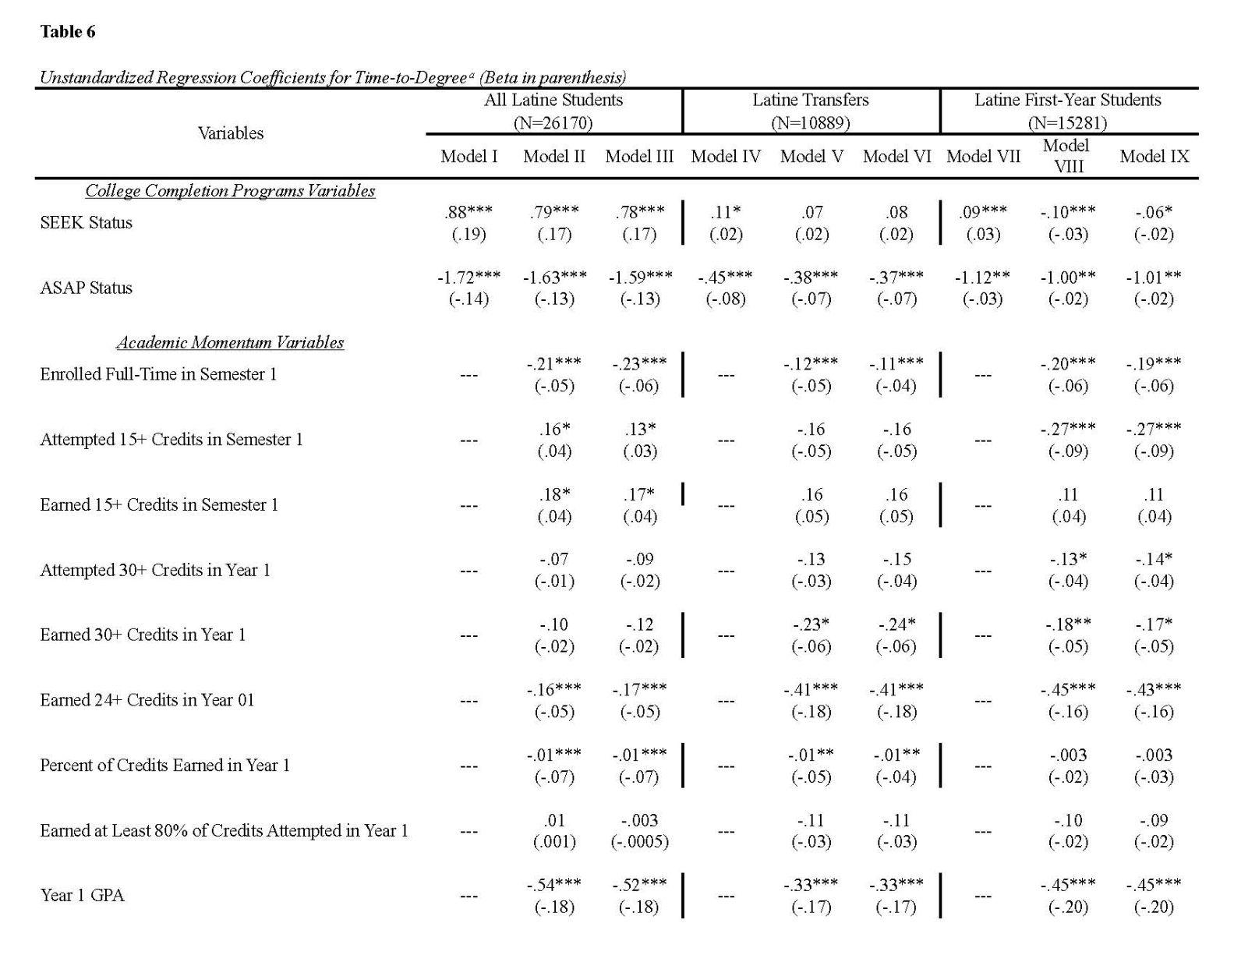

Slide 9
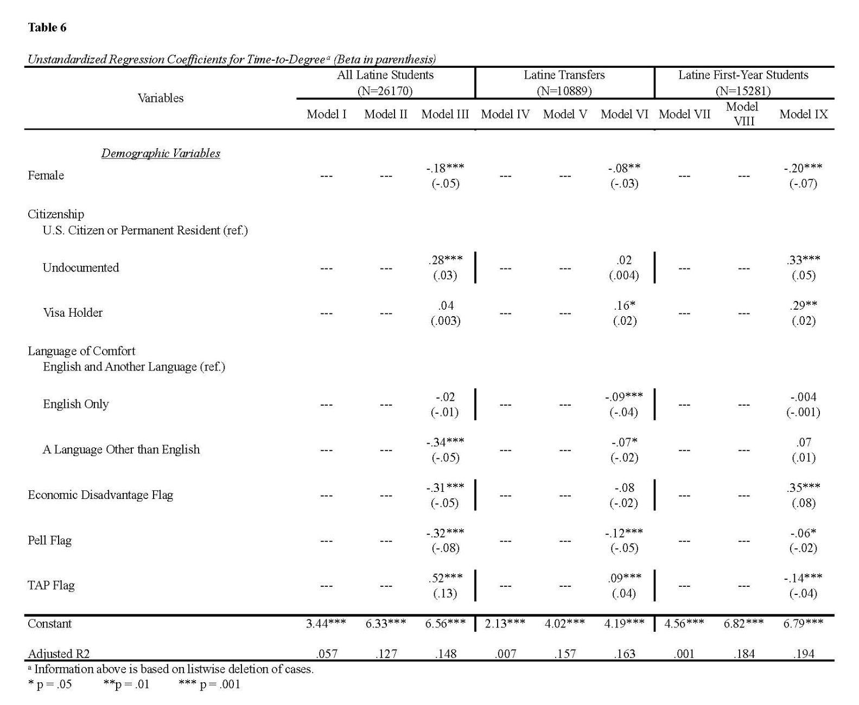

Slide 10
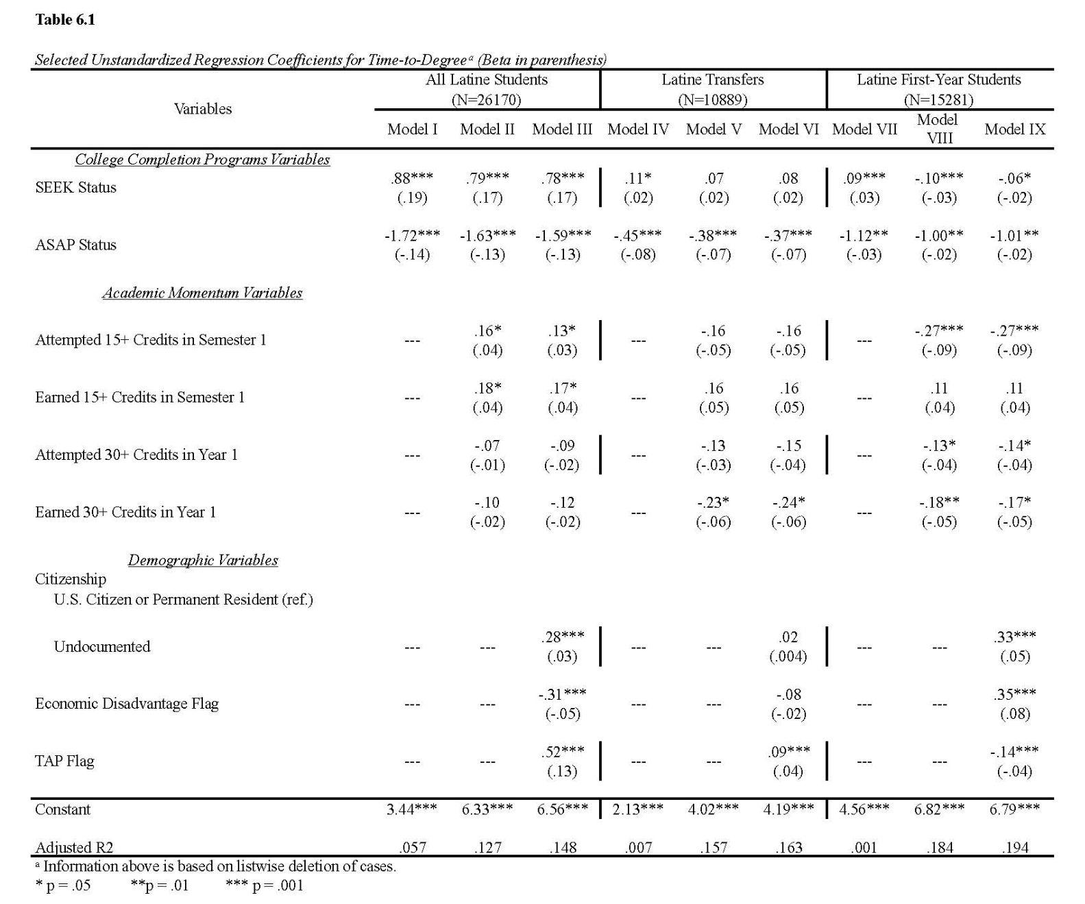
Selected Significant Findings

Slide 11
Discussion
College Completion Programs
(Bahr et al., 2013; Holcombe & Kezar, 2020; Jordan, 2021; Kolenovic et al., 2013; Todorova, 2019; Scrivener et al., 2015; Strumbos & Kolenovic, 2017; Verley II, 2020; Winograd et al., 2018)
(Adelman, 1999, 2006; Attewell et al., 2012; Attewell & Monaghan, 2016; Bahr et al., 2013; Belfield et al., 2016; Clovis & Chang, 2019; Complete College America, 2013; Davidson & Blakenship, 2017; Huntington-Klein & Gill, 2020; Yu & Fue, 2017; Zhang, 2019)
Educational Outcome:
Time-to-Degree
Academic Momentum
(Bean et al., 2011; Bound et al. 2012;
Borjian, 2018; Carales, 2020; C. Suarez-Orozco et al., 2019; Flink, 2018; Hsin & Reed, 2020; Mabel, 2020; Mccormack et al., 2014; Piña-Watson et al., 2016; Patler, 2018; Shapiro et al., 2016; Vasquez et al., 2020; Yasuike, 2019; Zarifa et al., 2018)
Demographics

Slide 12



Limitations
Entirely Quantitative
One Ethnic Group
Pre-COVID
Number of Transfer Credits

Slide 13

Implications
Students & Families
Faculty & Administrators
Inquire about available support services
Actively utilize support services
Speak with Financial Aid counselors
Integrate multiple student services
Course scheduling and credit accumulation strategies
Proactive support
Reduce and remove cost burdens
Transfer student receptivity
Policymakers
Increase funding for higher education
Incentivize institutional support for transfer students
Review implications of existing financial aid policies

Slide 14

Future Research
SEEK/CD versus ASAP
Qualitative studies
  Institutional contexts
  Narrative analysis of achievers
  Beneficial components of college completion programs
  Sources of support
Differing influences of credit attempts and credit completion thresholds
Undocumented students
Transfer student resilience

Slide 15
Thank You

