Slide 1
Time-to Degree: Bachelor’s Degree Completion for Latine First-Year & Transfer Students
Robert Kunicki
Urban Education Ph.D. Program
The Graduate Center, CUNY
Dissertation Committee
Professor Juan Battle (Chair), The Graduate Center, CUNY
Professor Anthony Picciano, Hunter College & The Graduate Center, CUNY
Professor Limarys Caraballo, Teachers College, Columbia University & The Graduate Center, CUNY

Slide 2

Research Questions
What is the relative impact of college completion programs, academic momentum, and key demographic variables on the length of time it takes Latine students to earn a bachelor's degree?
How do these domains impact time-to-degree for transfer Latine students and first-year Latine students respectively?

Slide 3


Statement of the Problem
Equity gaps in Latine educational attainment (Carnevale & Fasules, 2017, Schak et al., 2019)
Concentration at certificate and associate’s level (Hussar et al., 2020)
Bachelor’s degree outcomes (Horn & Skomsvold, 2011, U.S. Department of Education National Center for Education Statistics, 2017)
Lengthening time-to-degree (Bound et al., 2012, Princiotta et al., 2014, Witteveen & Attewell, 2021, Zarifa et al., 2018)
Influences on time-to-degree
  First Year Students
  Transfer Students

Slide 4
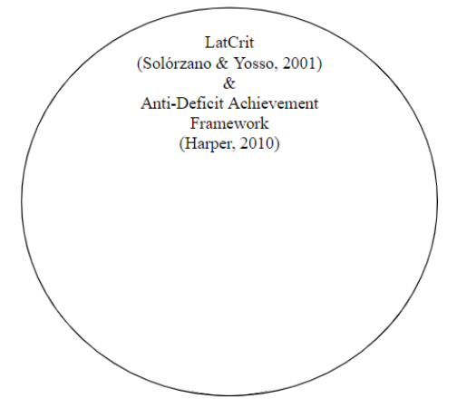

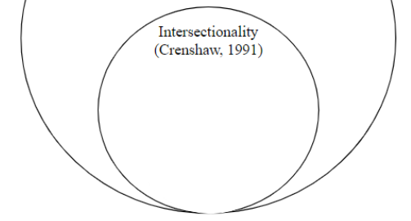
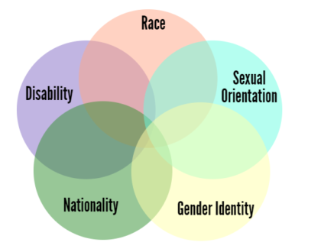
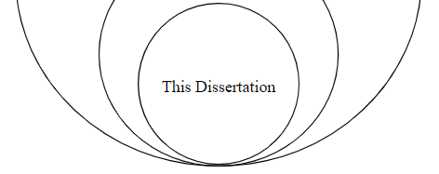
Theoretical Framework

Slide 5
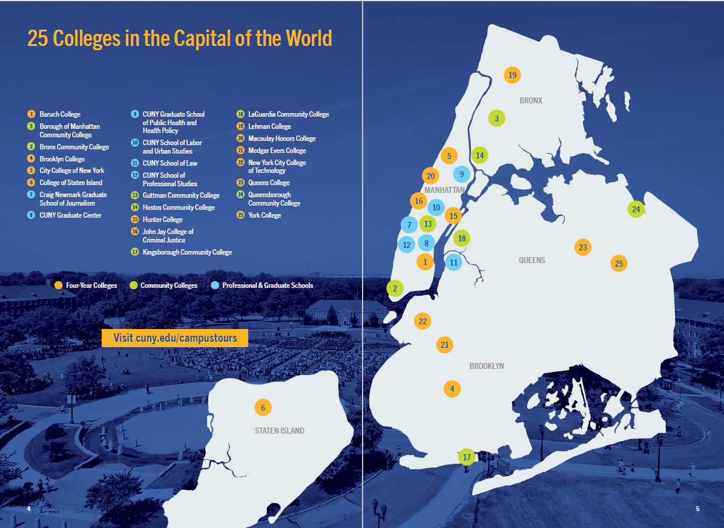
Data
City University of New York Policy Tracking Cohort (PTC)
De-identified student records from Fall 1999 - Fall 2019
Bachelor’s Degree Granting Institutions
  12 Colleges
  43,969 Hispanic Students

Slide 6
Models of Analytical Plan
College Completion Programs
(Holcombe & Kezar, 2020; Scrivener et al., 2015; Todorova, 2019)
(Attewell & Monaghan, 2016; Huntington-Klein & Gill, 2020)
Academic Momentum
Educational Outcome:
Time-to-Degree
Demographics
(Carales, 2020; Núñez, 2014)

Slide 7
Hierarchical Regression Models
Dependent Variable: Time-to-Degree for Latine Students
 | All Students |  |  | Transfer Students |  |  | First-Year Students
Models: | I | II | III | IV | V | VI | VII | VIII | IX
College Completion Programs | ✓ | ✓ | ✓ | ✓ | ✓ | ✓ | ✓ | ✓ | ✓
Academic Momentum |  | ✓ | ✓ |  | ✓ | ✓ |  | ✓ | ✓
Demographics |  |  | ✓ |  |  | ✓ |  |  | ✓

Slide 8
Thank You

